Slide 1
NARA Licensing Curriculum Training
The Balance Use of Authority in Licensing
Donna M. Sabo, MAED
NARA Consultant and Trainer
Sandi Wooters, MHS ACG
Commonwealth of PA

Slide 2
Learning Objectives
To identify personal issues
regarding authority
To identify problems with professional authority (overuse and underuse) relating to the regulatory field
To apply knowledge received to develop a better regulatory balance of authority

Slide 3
Life seems safer when..
Predictable, stable
Overtly fair
Respectful
Representing law and natural consequences, not capricious “personal” authority

Slide 4
Best Practices
YOU have great power and authority by virtue of your position.
Know yourself!
How do you react to authority?
Who was the first authority figure in your life?
Types of culturally based authority: Charismatic; traditional; rational-legal.
How do the providers react when you arrive?

Slide 5
Balance Use of Authority
We do not need to show authority to use it effectively.
Communication is key.
You walk softly but carry a big stick.
You must know how to manage your reactions and most importantly body language.
What are your triggers?
How do you redirect conversations?
Licensing is a human endeavor – are you comfortable with your feelings?

Slide 6
Balance: not to hard, not too soft –
JUST RIGHT - “Goldilocks
Personal relationships with providers
do not work.
Regulatory relationship’s require the use of fair, objective authority that is not contaminated by the conflict of interest.
All professionals have common goals; due diligence; objectivity and managing personal feelings.
What are licensing reps common goals?
Prevention is one of the primary regulators goals which protects the public through licensing.

Slide 7

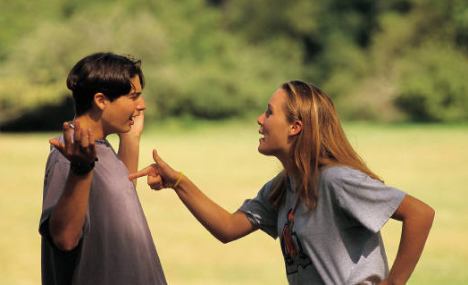
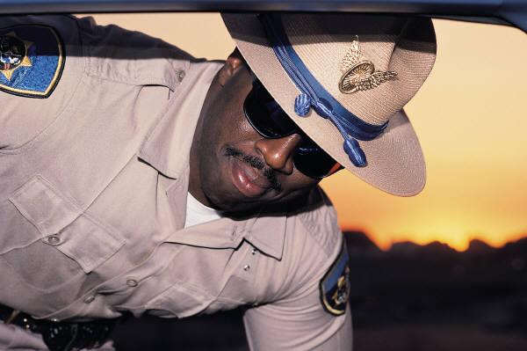
Problems with Authority
Past History
(ACES)
Personal History
Power imbalances

Slide 8
Limits and Latitudes
Equal Enforcement
Real Requirement
Can’t Change (Rules)

Slide 9
Vary use of authority on case-by-case basis
Professional collisions – keep in mind we license facilities operated by professionals –they may feel their professional commitment may supersede what licensing does.
Authority is necessary for an orderly society and accomplish tasks.
The review of regulatory compliance may cause a professional collision with providers who work very hard at serving a vulnerable population.
Notes:
Notice has to be “legally sufficient.”

Slide 10
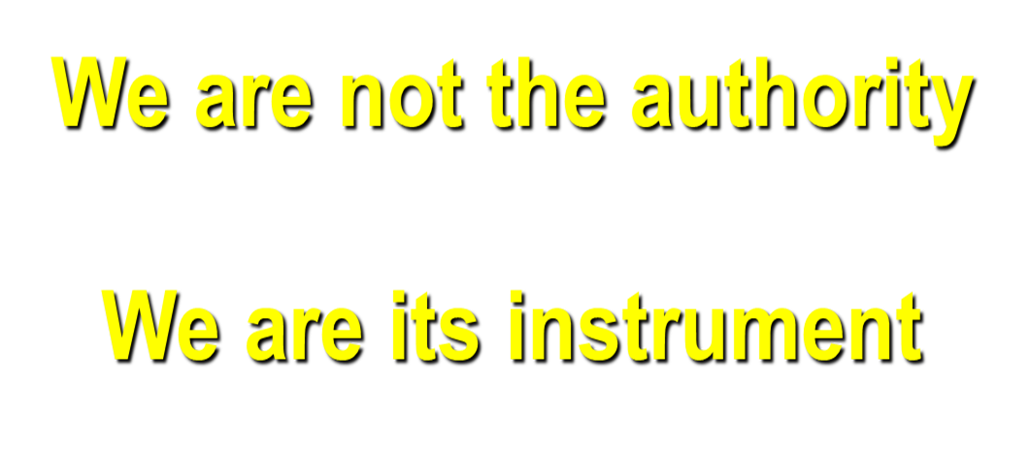
Authority Concept

Slide 11

Provider’s
Reactions
Before
During
After

Slide 12

Provider’s
Reactions
Fight
Flee
Freeze

Slide 13
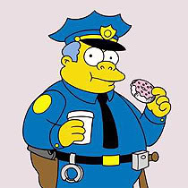
Characterizations of Providers
Can you name some “stereotypes” or types
of Providers???

Slide 14
“Victim”
Expects and wants to be the victim
Looks for signs of slight
Blames others

Slide 15
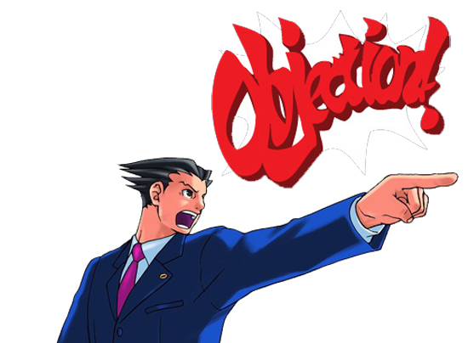
“Attorney”
Argues
technicalities
Looks for loopholes
Demonizes authority
Survives by wit and verbal skills

Slide 16
“Social Justice Advocate”
Takes on righteous defense of others
Paints the licensor as the bully or bigot
A safe way to challenge authority

Slide 17
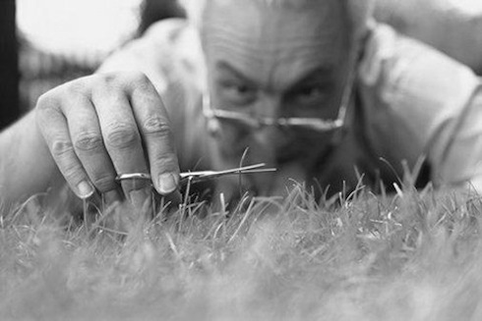
“Perfectionist”
Strives for perfection
Wards off disapproval
Avoids criticism
by learning to be perfect

Slide 18

Choreographer/Stage Mgr”
Obsessed with controlling
all the details
Making mistakes means vulnerability

Slide 19
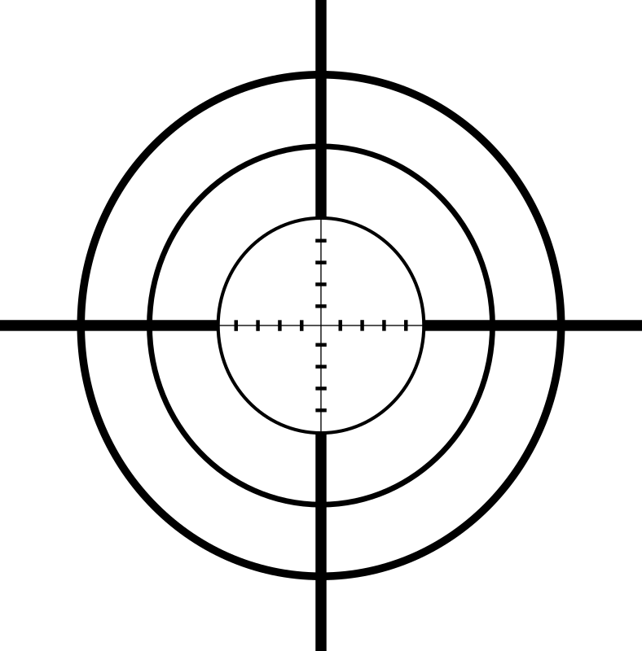
“Sniper”
Attacks authority
Aggressive verbal skills
Sees authority as the bully

Slide 20
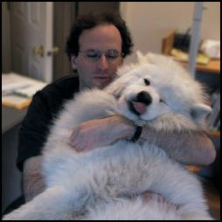
“Lapdog”
Overly
submissive
Unassertive
Confesses to false errors

Slide 21
“Junk-Yard Dog”
Aggressor
Bully
Bigot
Fight for survival
Mounting an attack feels safe

Slide 22
How would you handle these ?
Victim
Attorney
Social justice advocate
Perfectionist
Choreographer / Stage manager
Sniper
Lapdog
Junk-yard dog

Slide 23
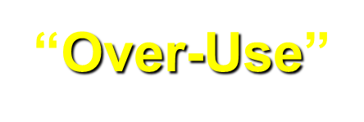
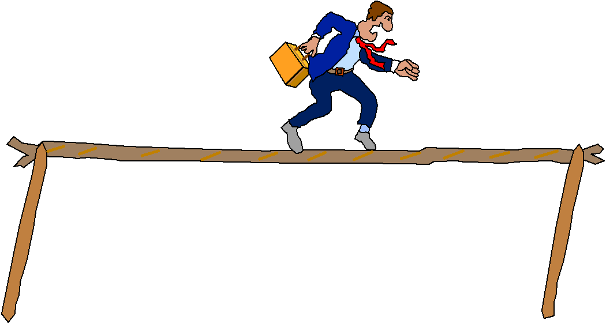
Staying Balanced
“Under-Use”

Slide 24
Under-Use of Authority
Weakens requirements
Unsafe environment
Parents think we assure safety

Slide 25
Under-Use of Authority
The consultant –TA/TA/TA
The Social worker
The go along
The eternal optimist
The over identifier
The apologist
The slipshod

Slide 26

“Consultant”
Avoids enforcement
Wants only to
“consult”
Easier role

Slide 27
“Social Worker”
Confuses role of regulator
with therapist
Views regulation is too negative
Not comfortable working within policy/regulation

Slide 28
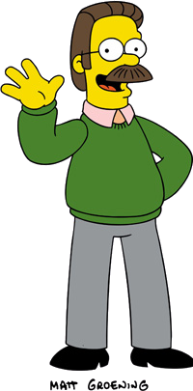
“Go-Along”
Allows licensee to take
control
Weak
Go along to get along

Slide 29
“Eternal Optimist”
“Everything is alright”
Avoids unpleasantness
Taken in by outward appearances

Slide 30
“Over-Identifier”
Over-involved with licensee
Emotionally caught up
in circumstances
Loses objectivity

Slide 31
“Apologist”
Blames rules on others
Offers no rationale for certain rules
May fail to require compliance

Slide 32
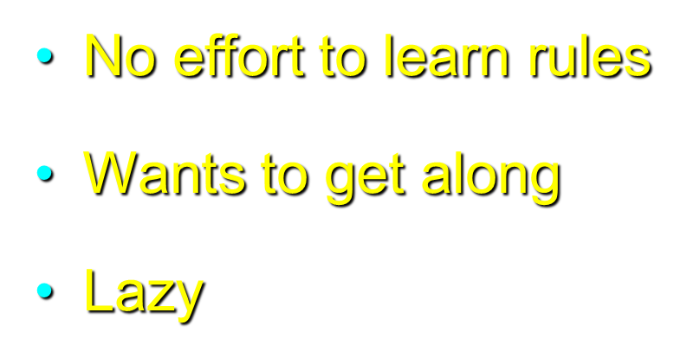
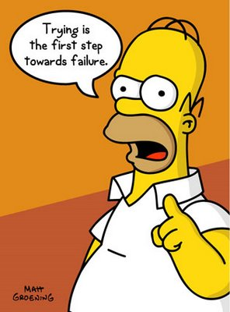
“Slipshod”

Slide 33
Overuse of Authority
I Gotcha
The Pessimist
The Masked Aggressor
The Midnight Raider
The Bigot
The Loner
The Crusading Advocate
The Unannointed Manager

Slide 34

““I Gotcha”
Determined to catch them
being bad
Overreacts
before getting
facts

Slide 35
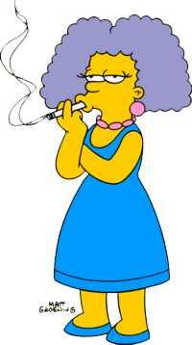
“Pessimist”
Expects licensee
is covering up violations
Expects licensee
cannot succeed/improve
Lack of faith in licensee

Slide 36

“Masked Aggressor”
Polite face to face
Lowers the boom
in writing
Passive aggressive

Slide 37

“Midnight Raider”
Expects to catch them “being bad”
Suspicious and wary of licensees
Overuses non-business-hours inspections

Slide 38
“The Bigot”
Possesses various biases
Hides biases behind professionalism
Plays favorites

Slide 39
“The Loner”
Uses personal judgment only
Loose cannon
Expects blind support
from management

Slide 40
“Crusading Advocate”
Duty to person in care overrides other duties
Oversteps bounds
Consultation obligatory

Slide 41
“Unannointed Manager”
Confuses roles
Dictates action to be taken
Takes over managerial role
for the facility

Slide 42
Misuse of Authority
Misuse of Authority is destructive for you, your agency, the provider and most importantly the children and families we serve.
The authority of law is what binds us together.
Licensing reps should be respectful, friendly and courteous but not friends with the providers.
Remember your role.
Regulating authority is conceptually and emotionally stressful to most providers…..even before a violation is issued or enforcement action taken.
Overuse of authority – abuse. Underuse or abdication of proper authority.

Slide 43
Concept of Prevention Protection
Licensing comes first to prevent danger. Regulators issue violations which gives providers the opportunity to correct or prevent harm.
Don’t feel guilty if the provider hasn’t maintained compliance.
Violations should be viewed as prevention and a positive process not punitive. Violations are licensing’s method of protection!

Slide 44
Rules apply equally to ALL providers
Regulators cannot substitute our professional opinions as the rules are the rules.
Licensing authority begins and ends with the rules.
If you are on a power trip this may be the wrong profession for you!

Slide 45
Distorted Relationships
Providers perceiving themselves in danger; fight, flee or freeze.
Knowing yourself will help understand/anticipate the providers reaction.
Think about a time when a violation was cited the provider disagreed with or became aggressive?
What was the cause of the providers reaction?
Do you see yourself in the providers shoes?

Slide 46
Tips for a Good Balance
Good communication
Use least enforcement needed
Use technical assistance appropriately

Slide 47
Tips for a Good Balance
Show respect
Use organizational resources
Observe limits and latitudes
Gather facts fully and objectively

Slide 48
Handling Challenging Situations
You will encounter offensive situations so be consistent in mood and behavior.
Being vigilant in knowing your own issues with authority – know yourself.
Stay out of traps.

Slide 49
Handling Challenging Situations
Take deep breaths; visualize yourself in a calm state; count backward slowly; redirect the conversation; concentrate on similarities/common interest in providing good care for the residents; practice good listening skills; all violations observed must be cited; use TA to explain possible POC; teach the intent of the regulation; be fair and objective/specific; gather facts fully; provide findings promptly – no gotcha’s; learn and practice good verbal and nonverbal communications.

Slide 50
Handling Challenging Situations
A smile, courtesy, respect, and manners go a long way. (please, thank you, may I?)
Human Interactions – authority is defined as a bond between people who are unequal. Like parent/child; student/teacher; employer/employee; license rep/provider.
You hold something providers want/need – “the license” no reason to misuse the “Balance of Authority”

Slide 51

Life’s a Great Balancing Act
So be sure when you step.
Step with care and great tact
and remember that life's a great balancing act.
Just never forget to be dexterous and deft.
And never mix up your right foot with your left.
Dr. Seuss

Slide 52
